Slide 1

Bioinformatic approaches to regulatory genomics and epigenomics
376-​1347-00L | week 05
Pierre-Luc Germain

Slide 2
Plan
Debriefing on the assignment
The ‘histone code’ & functional elements
More on overlaps and comparing signals

Slide 3
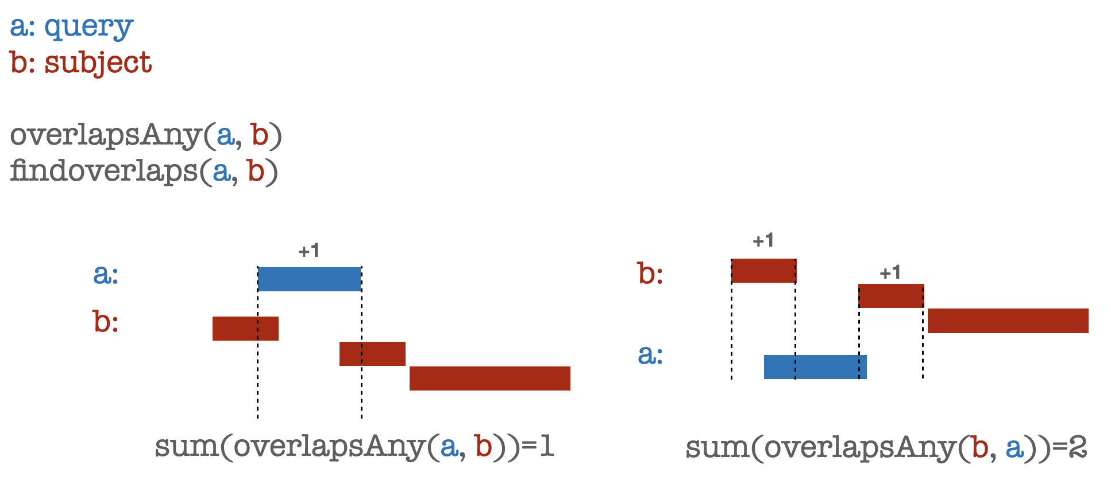
Debriefing on the assignments
Symmetry of overlaps:

Slide 4
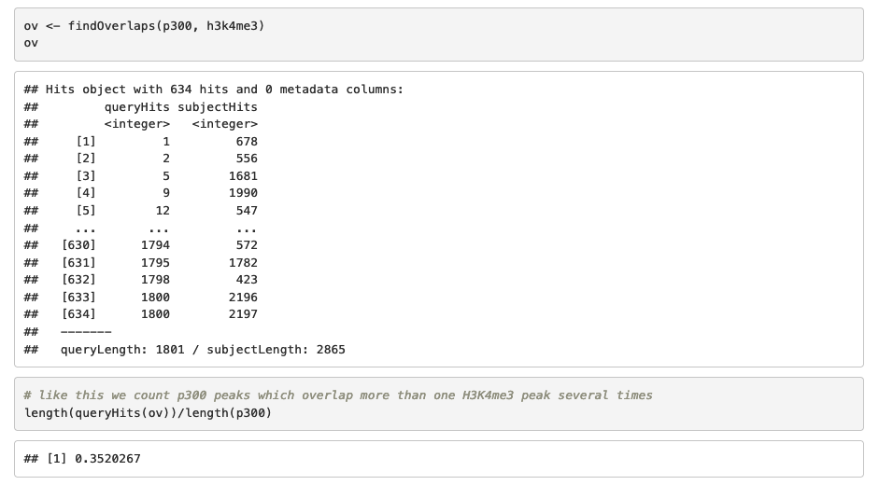
findOverlaps vs overlapsAny

Slide 5
findOverlaps vs overlapsAny
be aware of that one peak in the query might overlap several in the subjects

Slide 6
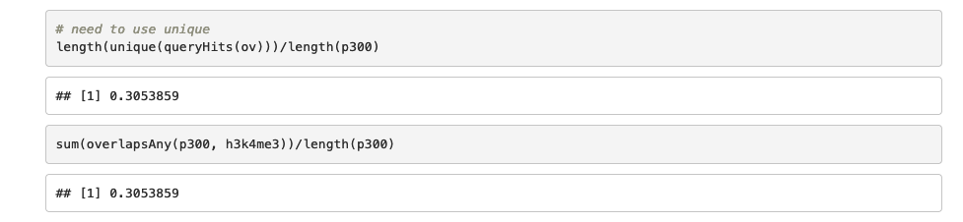
findOverlaps vs overlapsAny
correct solution

Slide 7
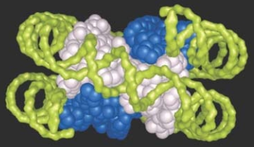
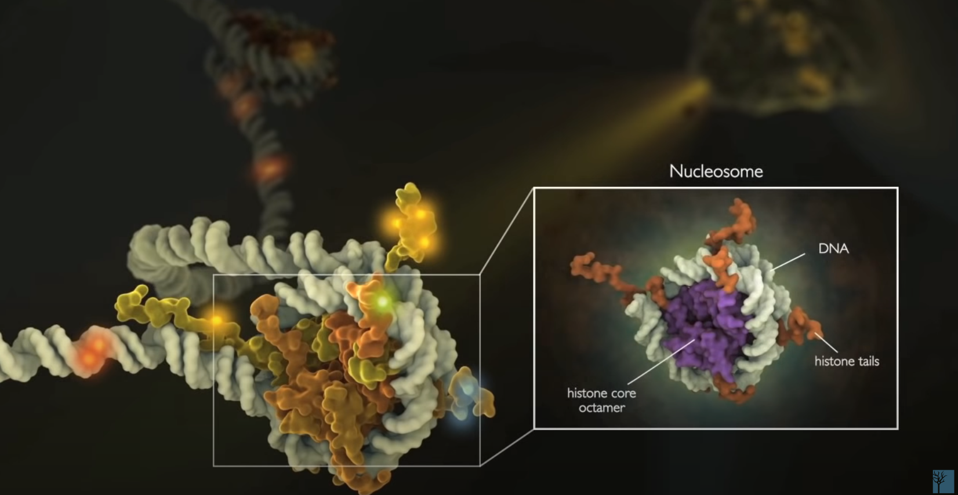
Nucleosome
(Krebs et al., 2018)
Cell Signaling

Slide 8
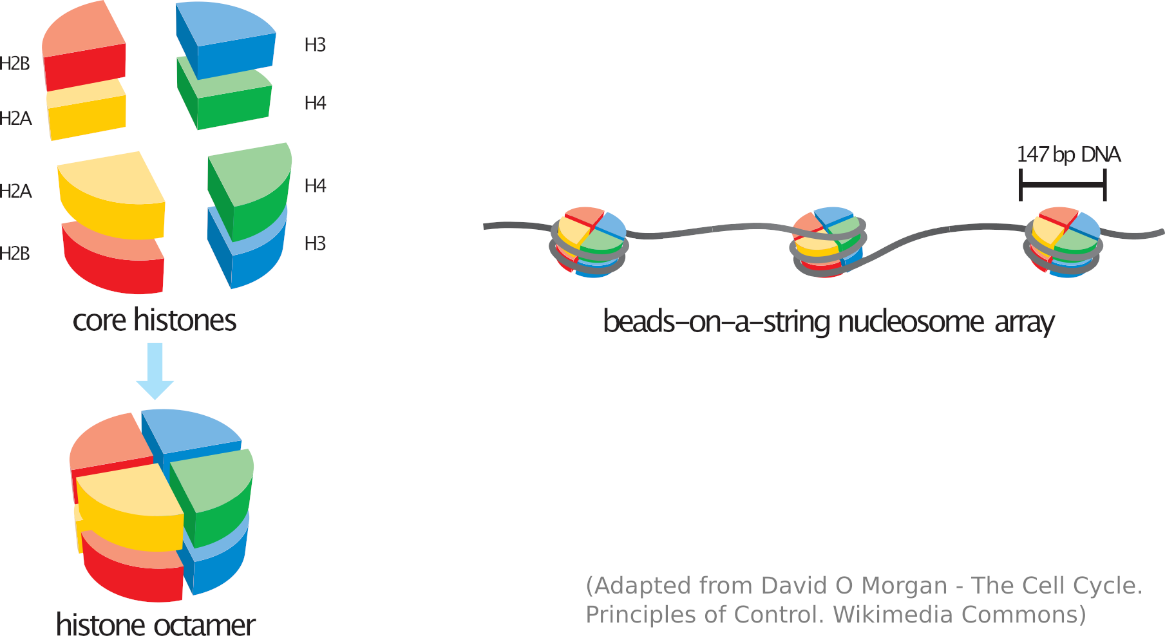
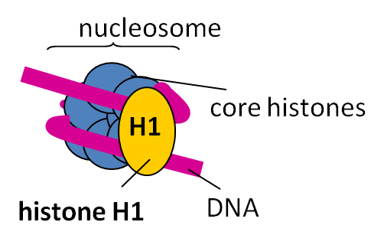

Slide 9
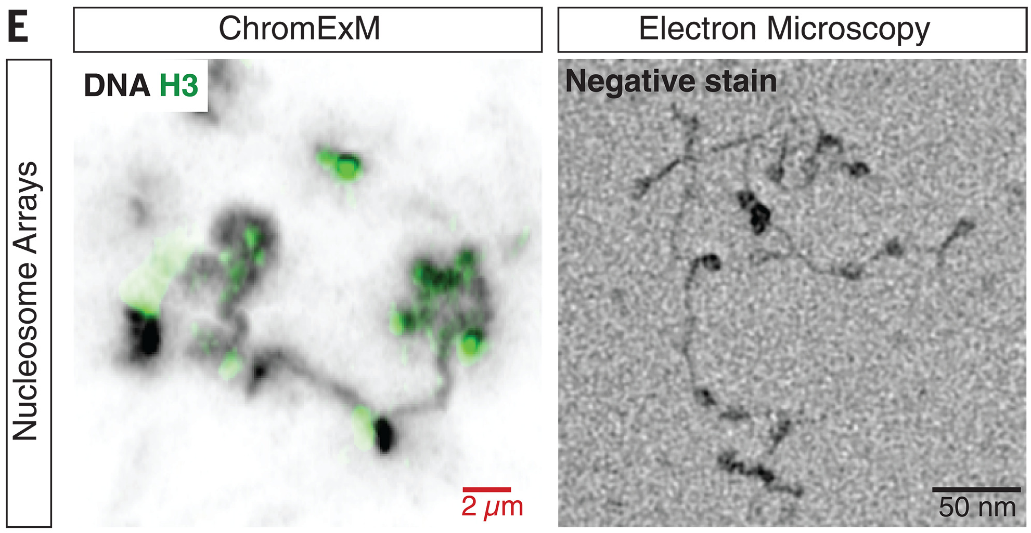
Viewing the beads-on-a-string of DNA and nucleosomes
(Adapted from Pownall et al., Science 2023)

Slide 10
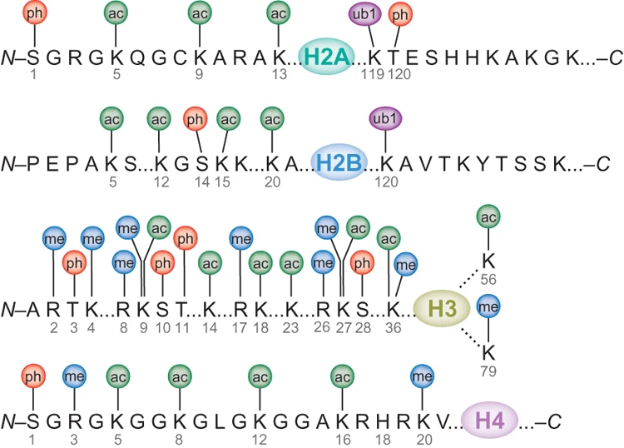
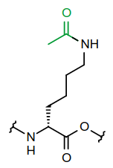
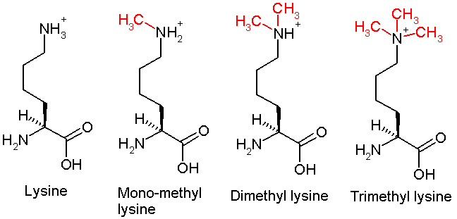
Many residues on the histone tails can be post-translationally modified
H3K27ac
(Bhaumik, Smith and Shilatifard 2007)
H3K27… me me2 me3

Slide 11
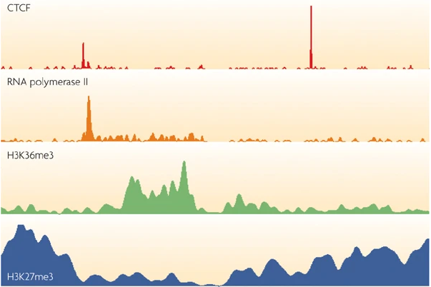
Some histone modifications appear to be very localized, e.g. happening on a specific nucleosome, while most are much more broadly distributed
The strategy of calling ‘peaks’ must therefore be adapted
(e.g. “broad” option of most peak-callers)
(Park, Nat Rev Gen 2009)

Slide 12
There is a very strong association of certain histone marks and activation or repression
Repressive complex
Polycomb
Trithorax
Activating complex
mutually
exclusive
H3K27ac
H3K27me3
Histone modifications
H3K4me
Repressed
Active
Gene expression
But which comes first?

Slide 13

Causality or correlation?
Are histone modifications responsible for activation/repression, or are they merely associated side-effects?
( https://xkcd.com/552 )

Slide 14
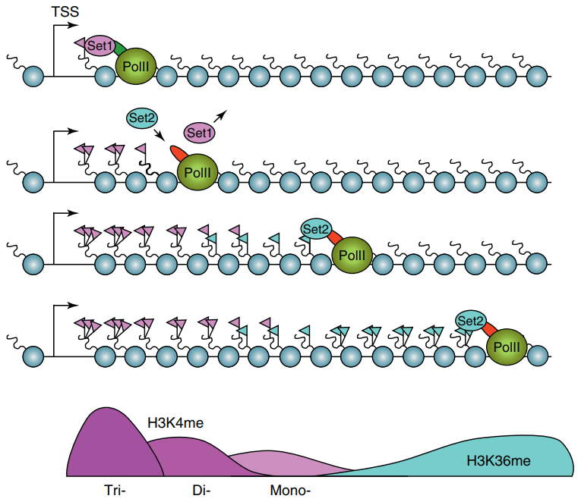
Transcription-mediated histone modification
(Henikoff and Shilatifard 2011)

Slide 15
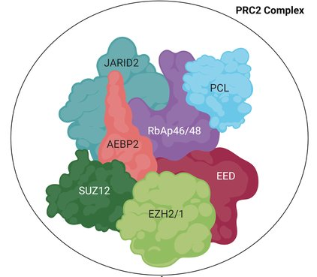
The example of H3K27me3, chiefly deposited by the
polycomb repressive complex (PRC2)
Abolishing the enzymatic activity of Ezh2, the gene responsible for depositing H3K27me3, abolishes (most of) the mark but does not prevent the repression of the target genes, nor cellular reprogramming
(Fragola et al., PLoS Genetics 2013)
EHZ2’s SET domain catalyzes the addition of a 3rd methyl group to H3K27,
i.e. H3K27me2 → H3K27me3
(Adapted from Zoroddu et al., 2021)

Slide 16
Causality or correlation?
Other examples…
For H3K27ac, blocking the deposition of the mark does not prevent pioneering factors (PF) from opening local chromatin, whereas blocking the factors prevents H3K27ac to most sites
Similarly, the loss of H3K4me3 appears to have no effect on nascent transcription
(Murray et al., bioRxiv 2019)
(Miao et al., Molecular Cell 2022)

Slide 17
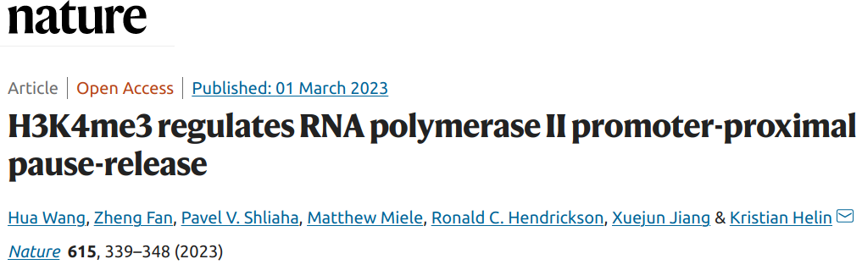
“acute loss of H3K4me3 does not have detectable effects on transcriptional initiation but leads to a widespread decrease in transcriptional output, an increase in RNA polymerase II (RNAPII) pausing and slower elongation. We show that H3K4me3 is required for the recruitment of the integrator complex subunit 11 (INTS11), which is essential for the eviction of paused RNAPII and transcriptional elongation.”

Slide 18
Causality or correlation?
Histone modifications
attract/
repel
deposit
Most likely somewhere in the middle, depending on the modification/context
Protein complexes
Functional
impact
Whether they’re causative or not, they can serve as proxies for function.
This means that profiling a few histone modifications gives an overview of the epigenomic landscape of a cellular state which would otherwise require profiling all the potentially-relevant factors/complexes

Slide 19
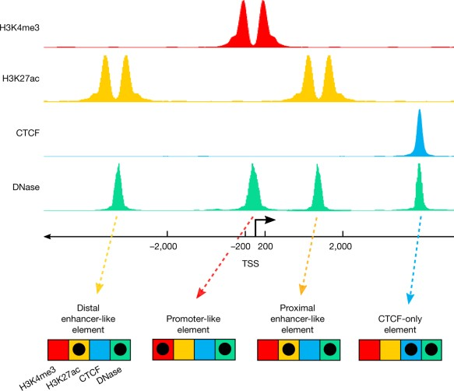
A signature-based encyclopedia of DNA elements
segmentation
enh
prom
enh
ENCODE’s “signature strategy”:
Different types of functional genetic elements are associated with different chemical signatures
We can identify functional elements by identifying these signatures genome-wide

Slide 20
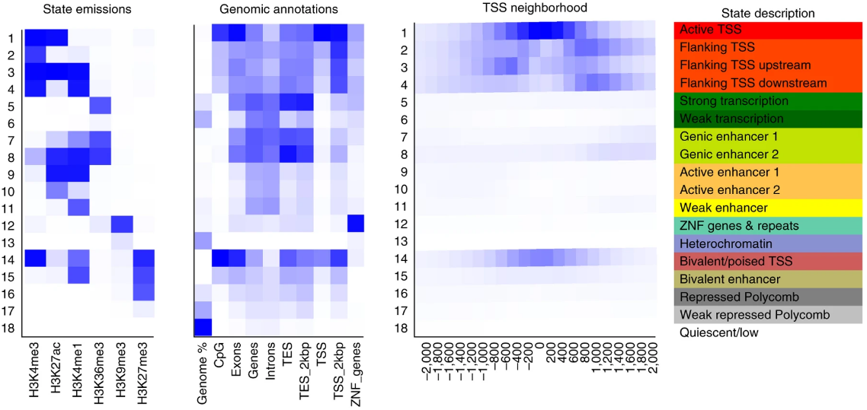
So how many kinds of functional elements/states are there?
(Ernst and Kellis, Nat Protoc 2017)

Slide 21
Some stuff is pretty clear:
Transcription start site (TSS):
H3K4me3 is almost always associated with active/poised TSS
Active TSS are marked by H3K27ac
So-called “poised” (or bivalent) TSS are instead marked by both H3K4me3 and H3K27me3
Enhancers:
Most enhancers have H3K4me1
Active enhancers are marked by H3K27ac
So-called “poised” (or bivalent) enhancers are marked by H3K4me1 and H3K27me3
Repressed elements are marked by H3K27me3
Heterochromatin is marked by H3K9me3
Insulators: CTCF+cohesin

Slide 22
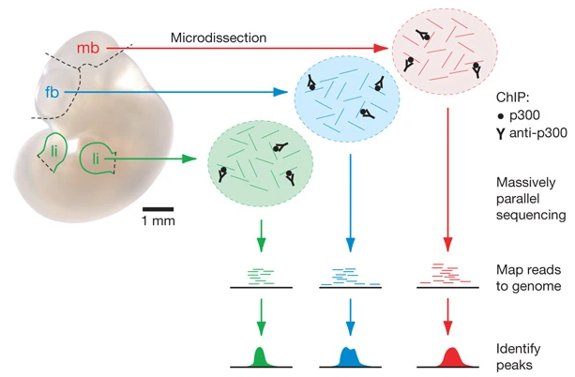
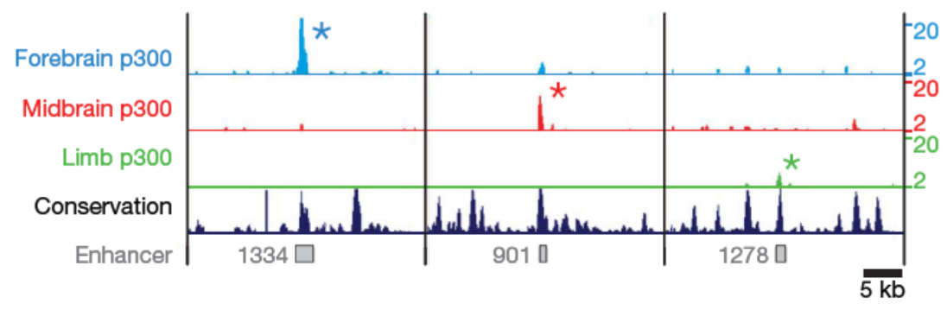
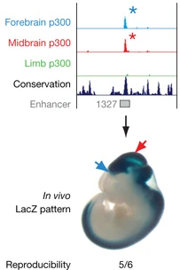
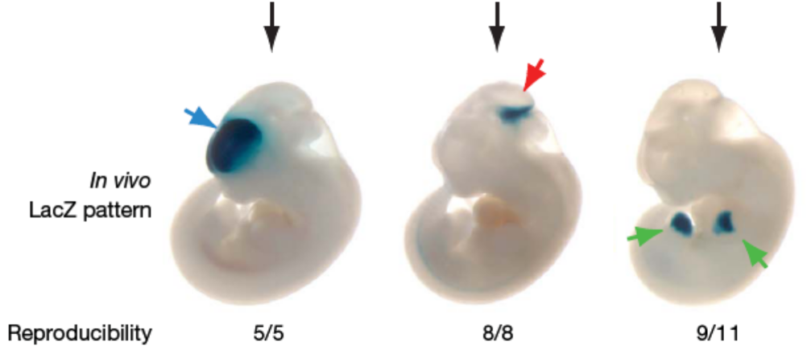
p300 and validation of enhancer activity
sequence
clone into a reporter vector
enhancer sequence
mp
reporter
(Adapted from Visel et al., 2009)
vista enhancers: http://enhancer.lbl.gov

Slide 23
Assignment
Using the peaks you downloaded last week, identify bivalent domains (H3K27me3 + H3K4me3) in human embryonic stem cells (ESC)
What happens to those regions upon differentiation?
Choose one differentiated cell type (e.g. hepatocytes, neural progenitor, or smooth muscle cells)
Download the H3K27me3 and H3K4me3 peaks from this cell type
How many of the ESC bivalent domains are, in this differentiated cell type, overlapping either mark or their combination (in this differentiated cell type)?
Don’t forget to upload your assignment as “assignment.html” !

